Slide 1


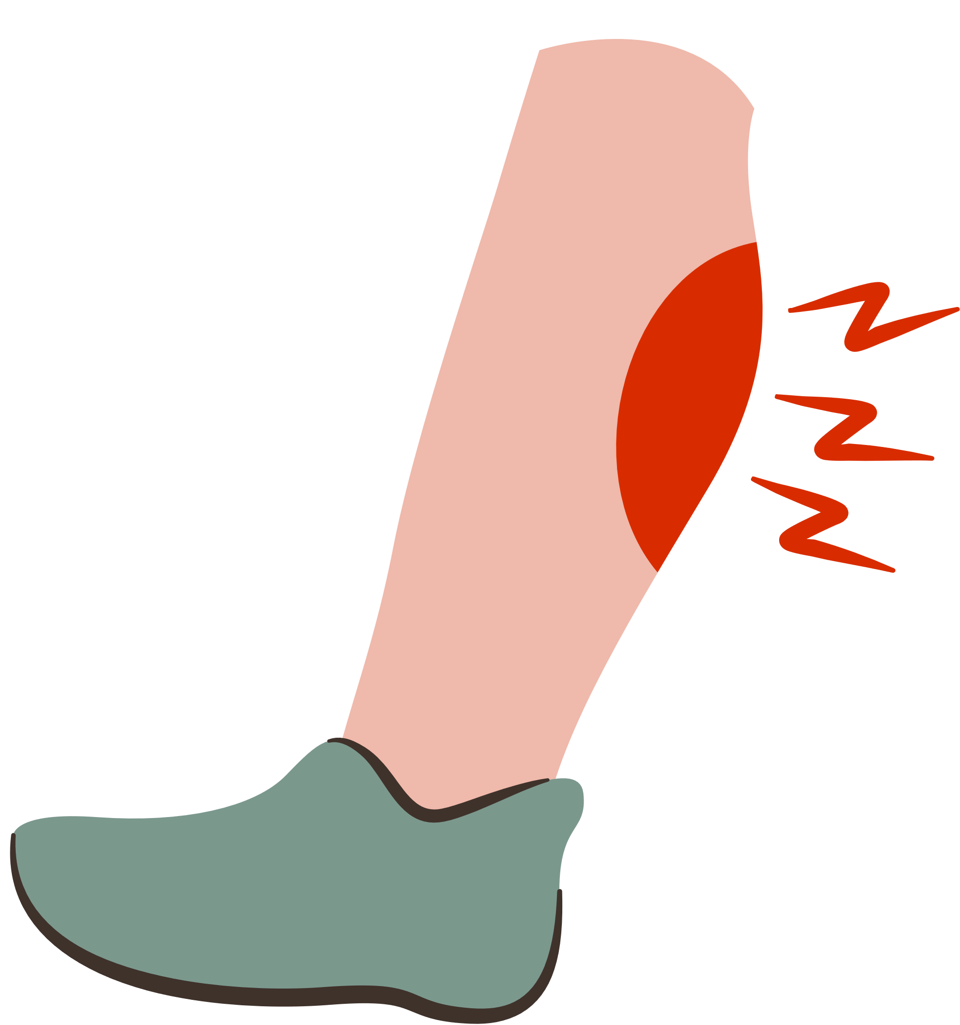



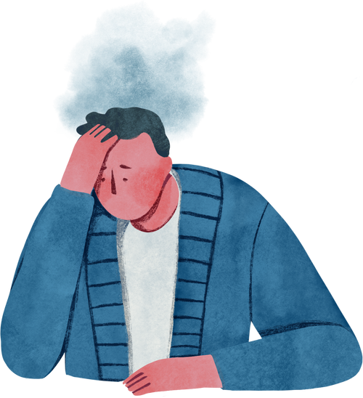
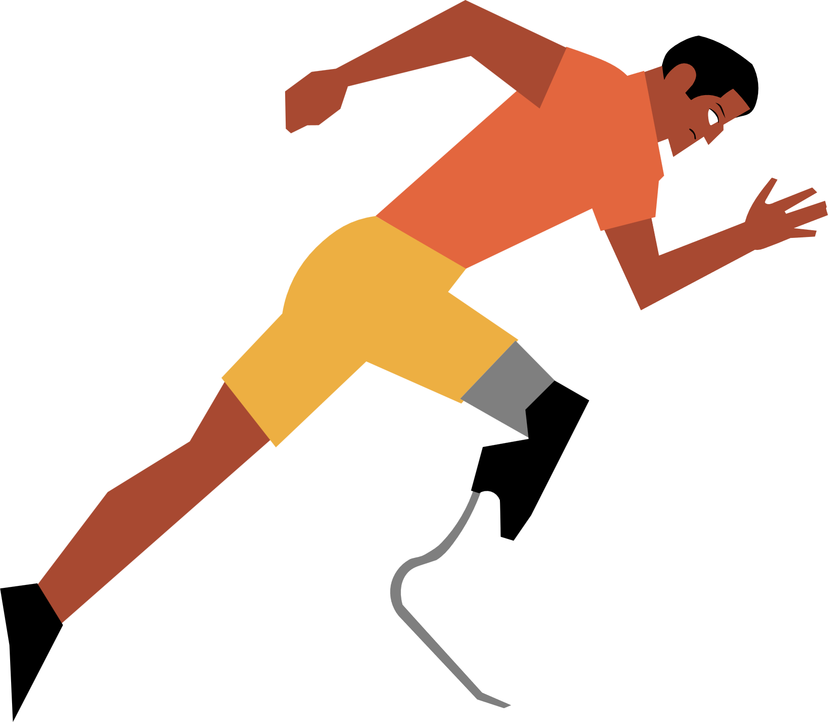





Lightning Talk 2:
Problem & Users
PRESSURE SENSOR PATCH
sdmay25-12
Advisor: Santosh Pandey
Client: BAE Systems
Notes:
Hello, we are senior design team 12 and our project is the Pressure Sensor Patch with BAE Systems and Adaptive Adventures.

Slide 2

Project Overview
The pressure sensor patch project aims to help individuals with traumatic injuries monitor excessive pressure on their skin to prevent pressure sores.
This wearable technology offers a convenient, non-invasive way to track skin health and alert users before damage occurs.
Notes:
The Pressure Sensor Patch project consists of both a wearable device and a mobile phone app and is designed to help those with traumatic injuries monitor excessive pressure on areas of their body in order to avoid pressure sores. Essentially the device monitors the amount of pressure and time it has been applied to a particular body part and alerts the user to relieve that pressure before damage occurs.

Slide 3
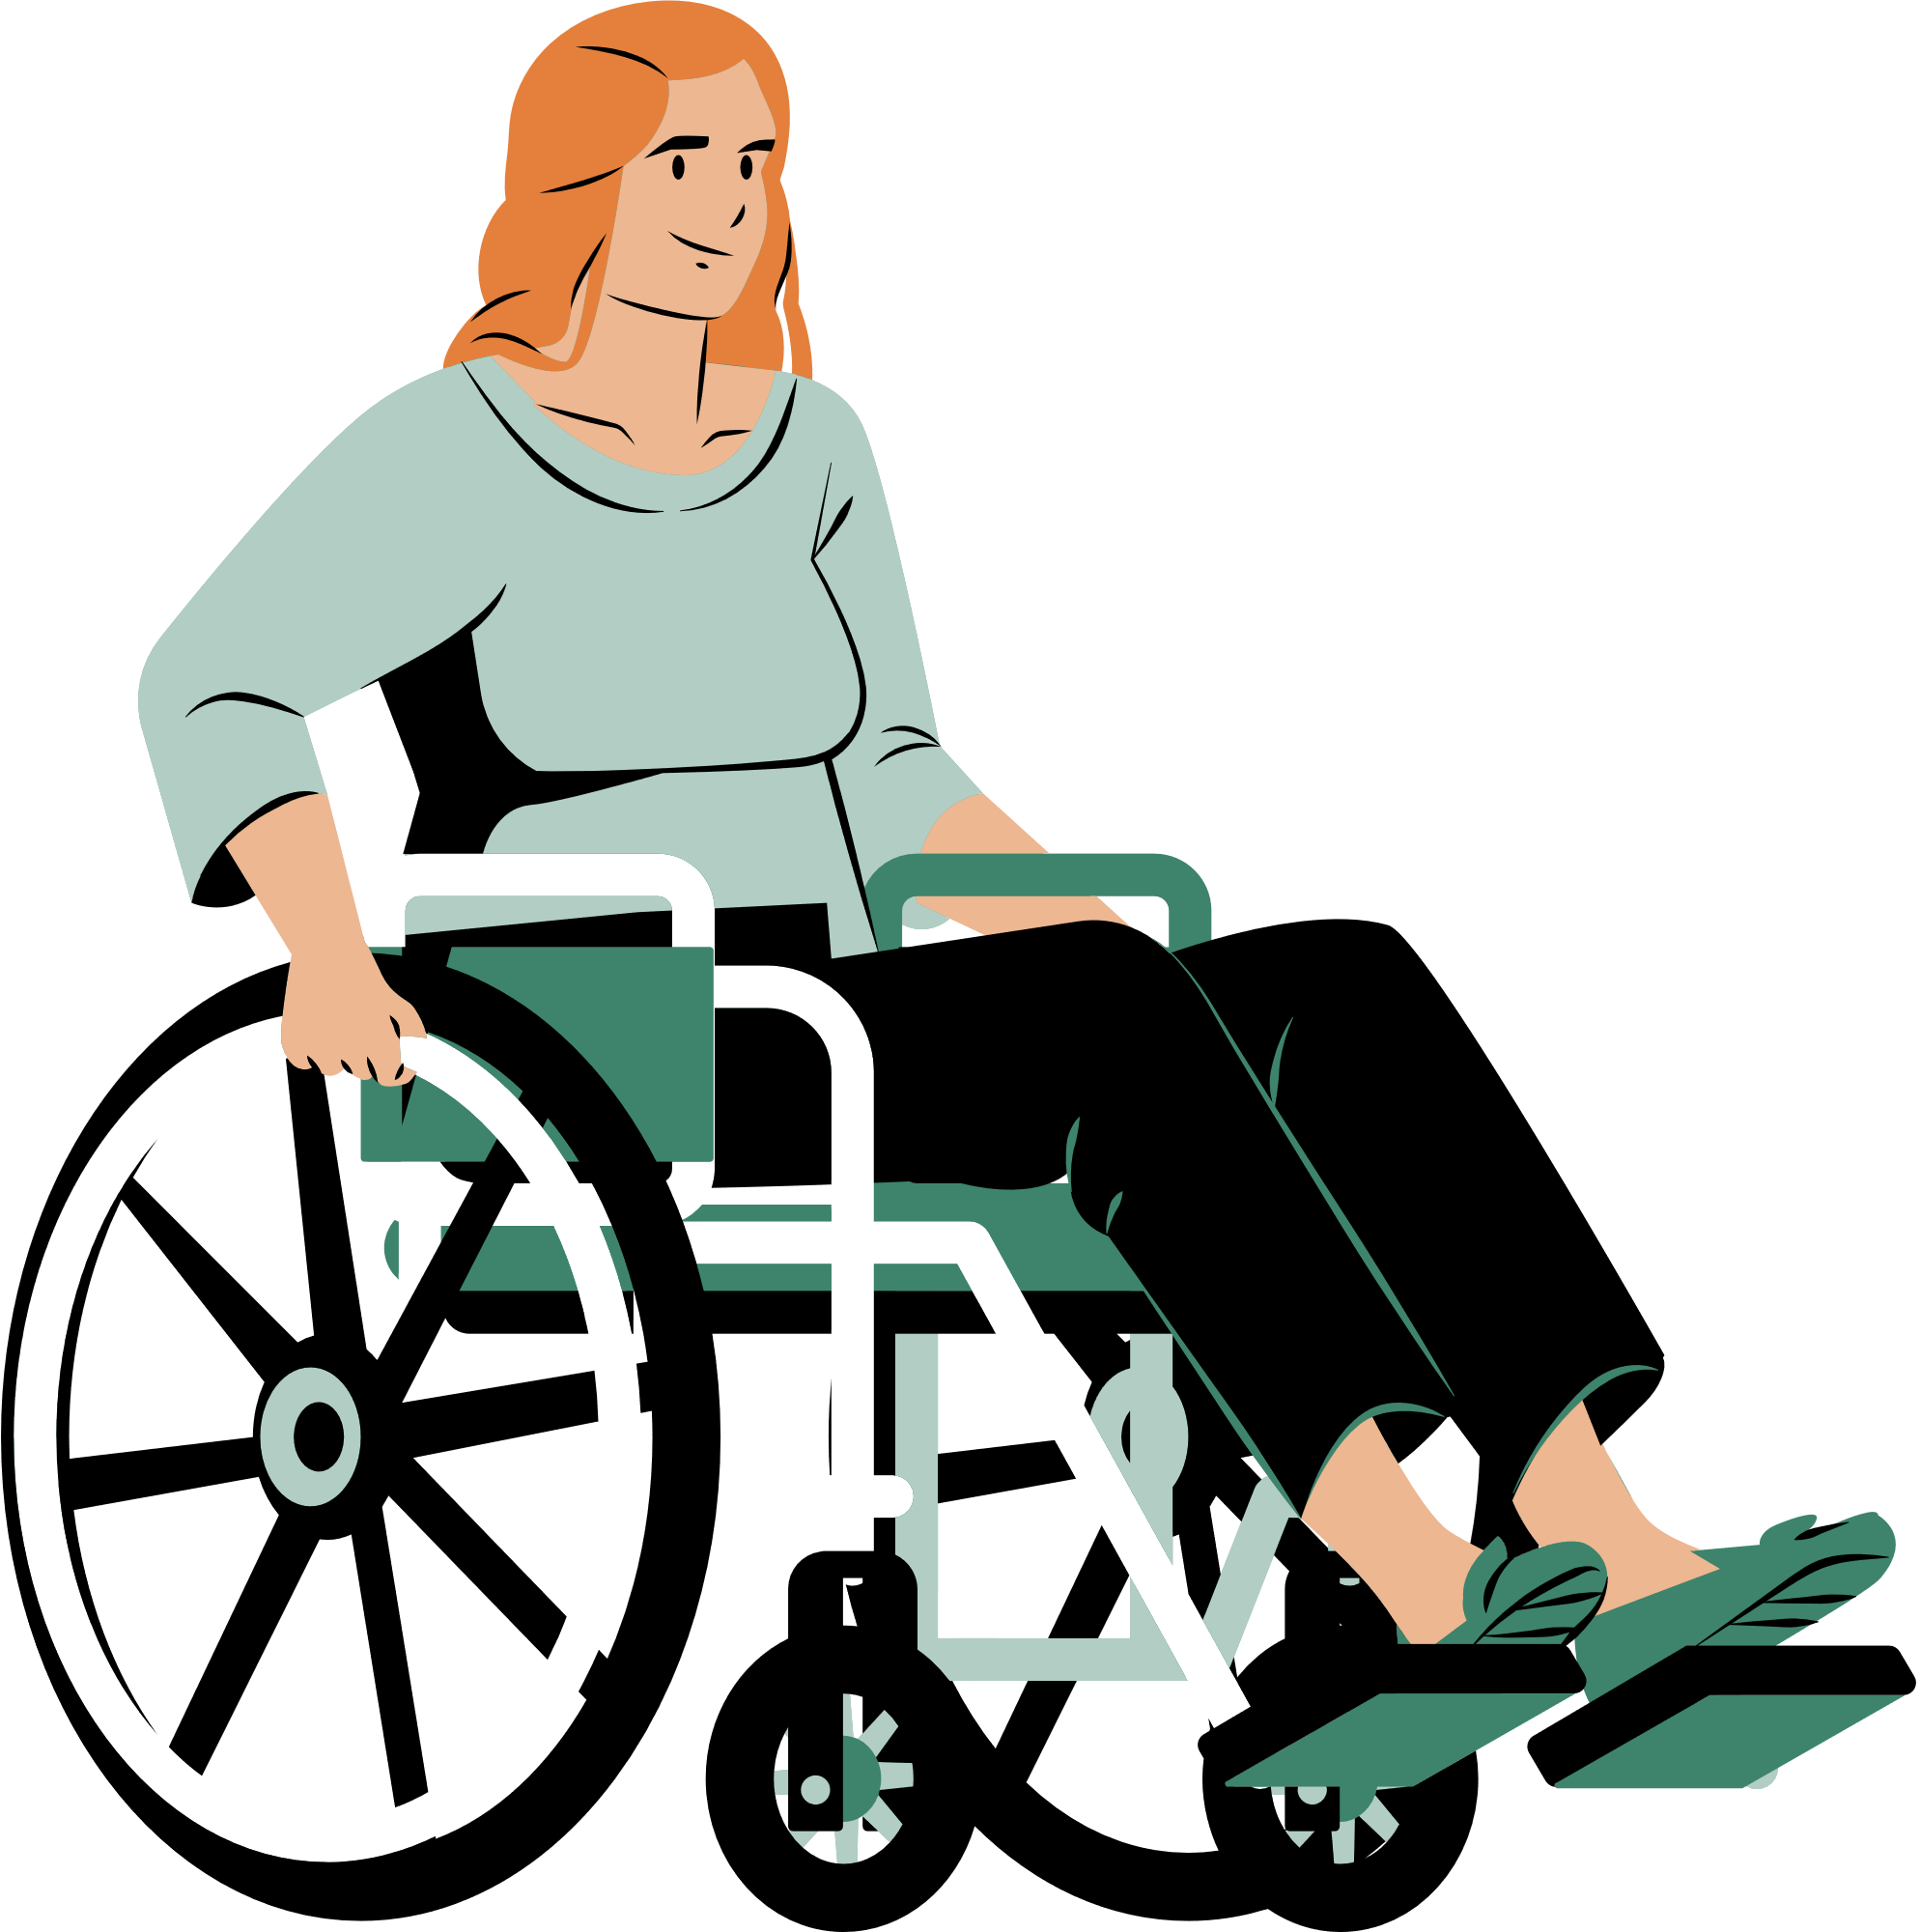
Problem Statement
Pressure sores are a common issue for individuals with limited mobility.
Prolonged pressure on the skin can cause tissue damage, leading to infections and other serious health complications.
Early detection and intervention are crucial to preventing these injuries.
Notes:
Since most of our users are in wheelchairs everyday for long periods of time
pressure sores are a common issue for them
The prolonged pressure on the skin from sitting in their wheelchairs can cause tissue damage
this can lead to infections and other serious health complications
Because of these issues
early detection and intervention are crucial to preventing these injuries

Slide 4

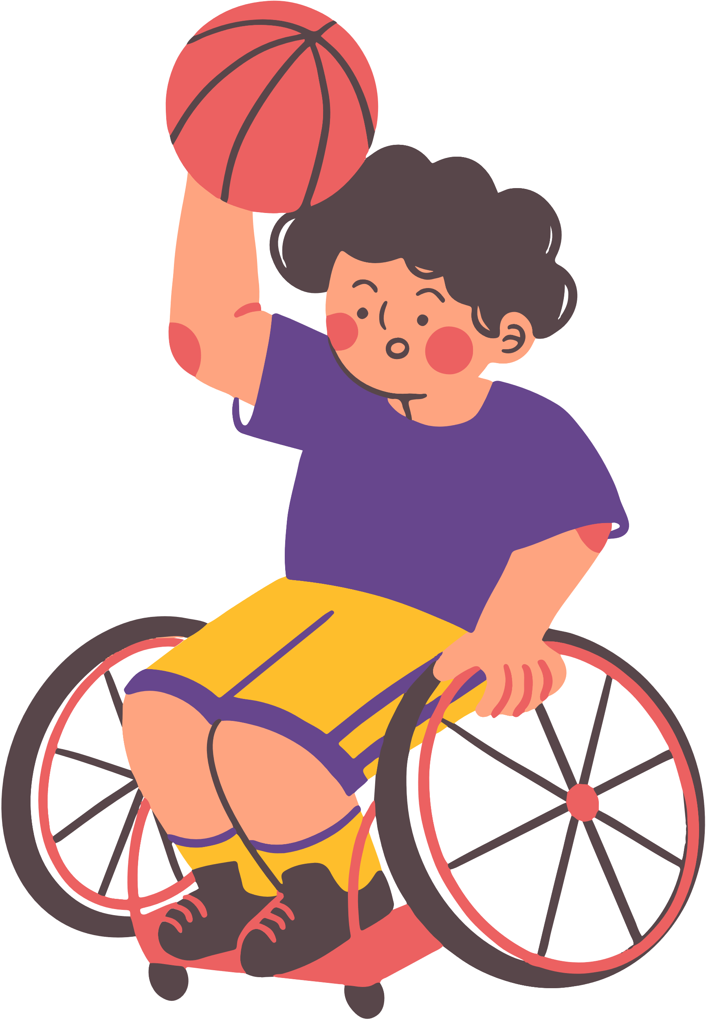
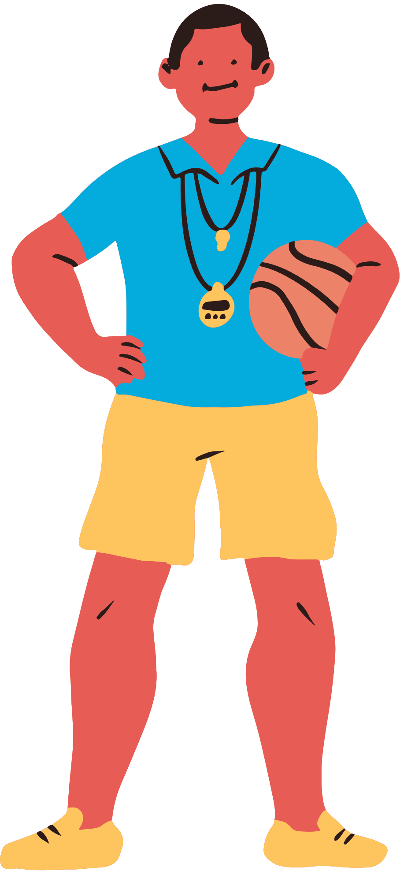

Users and Personas
Individuals with adaptive equipments
Caregivers
Healthcare providers
Notes:
Detail that we identified these specific users
Talk briefly about what each is
about 35-45 seconds total
Adaptive individuals
Playing sports
They have the actual pressure they cant feel
Caregivers
Coaches or aids
They should know how the system works
Healthcare providers
Should know how the system works
Can recommend preventative measures based on feedback from the device

Slide 5

Users Needs
Data Insights
By monitoring pressure distribution b/w contact surface & sensors, the area experiencing abnormal distribution can be identified enabling preventative action
Notes:
Now that we identified the Users, we can narrow down their needs. Starting with Data Insights

Slide 6


Users Needs
Real-time Alerts
Users need immediate notifications when pressure levels exceed safe thresholds on their damaged area of skin. This allows them to shift their position and avoid damaging their health conditions.

Slide 7

Users Needs
Ease of Use
The pressure sensor patch must be easy to apply and maintain,
with minimal user intervention.

Slide 8
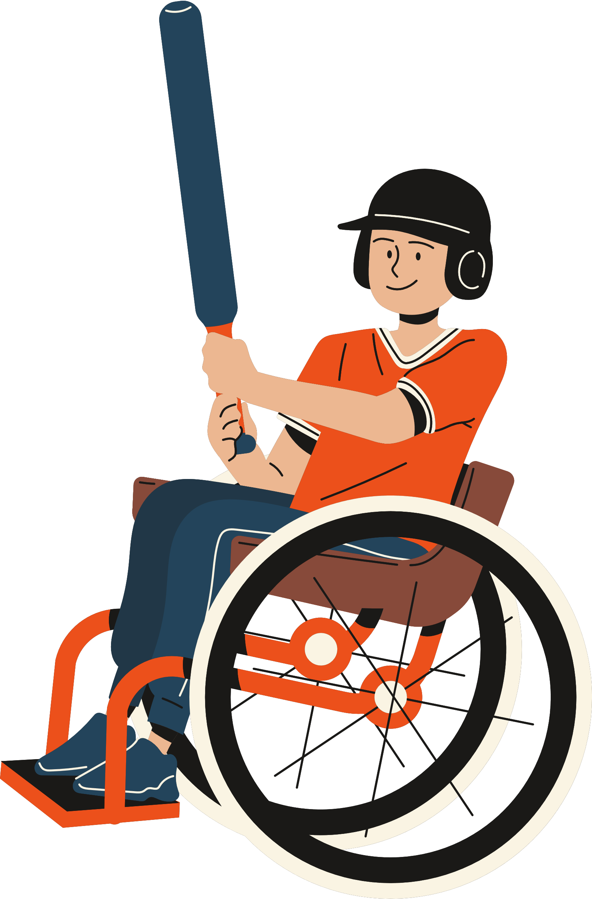
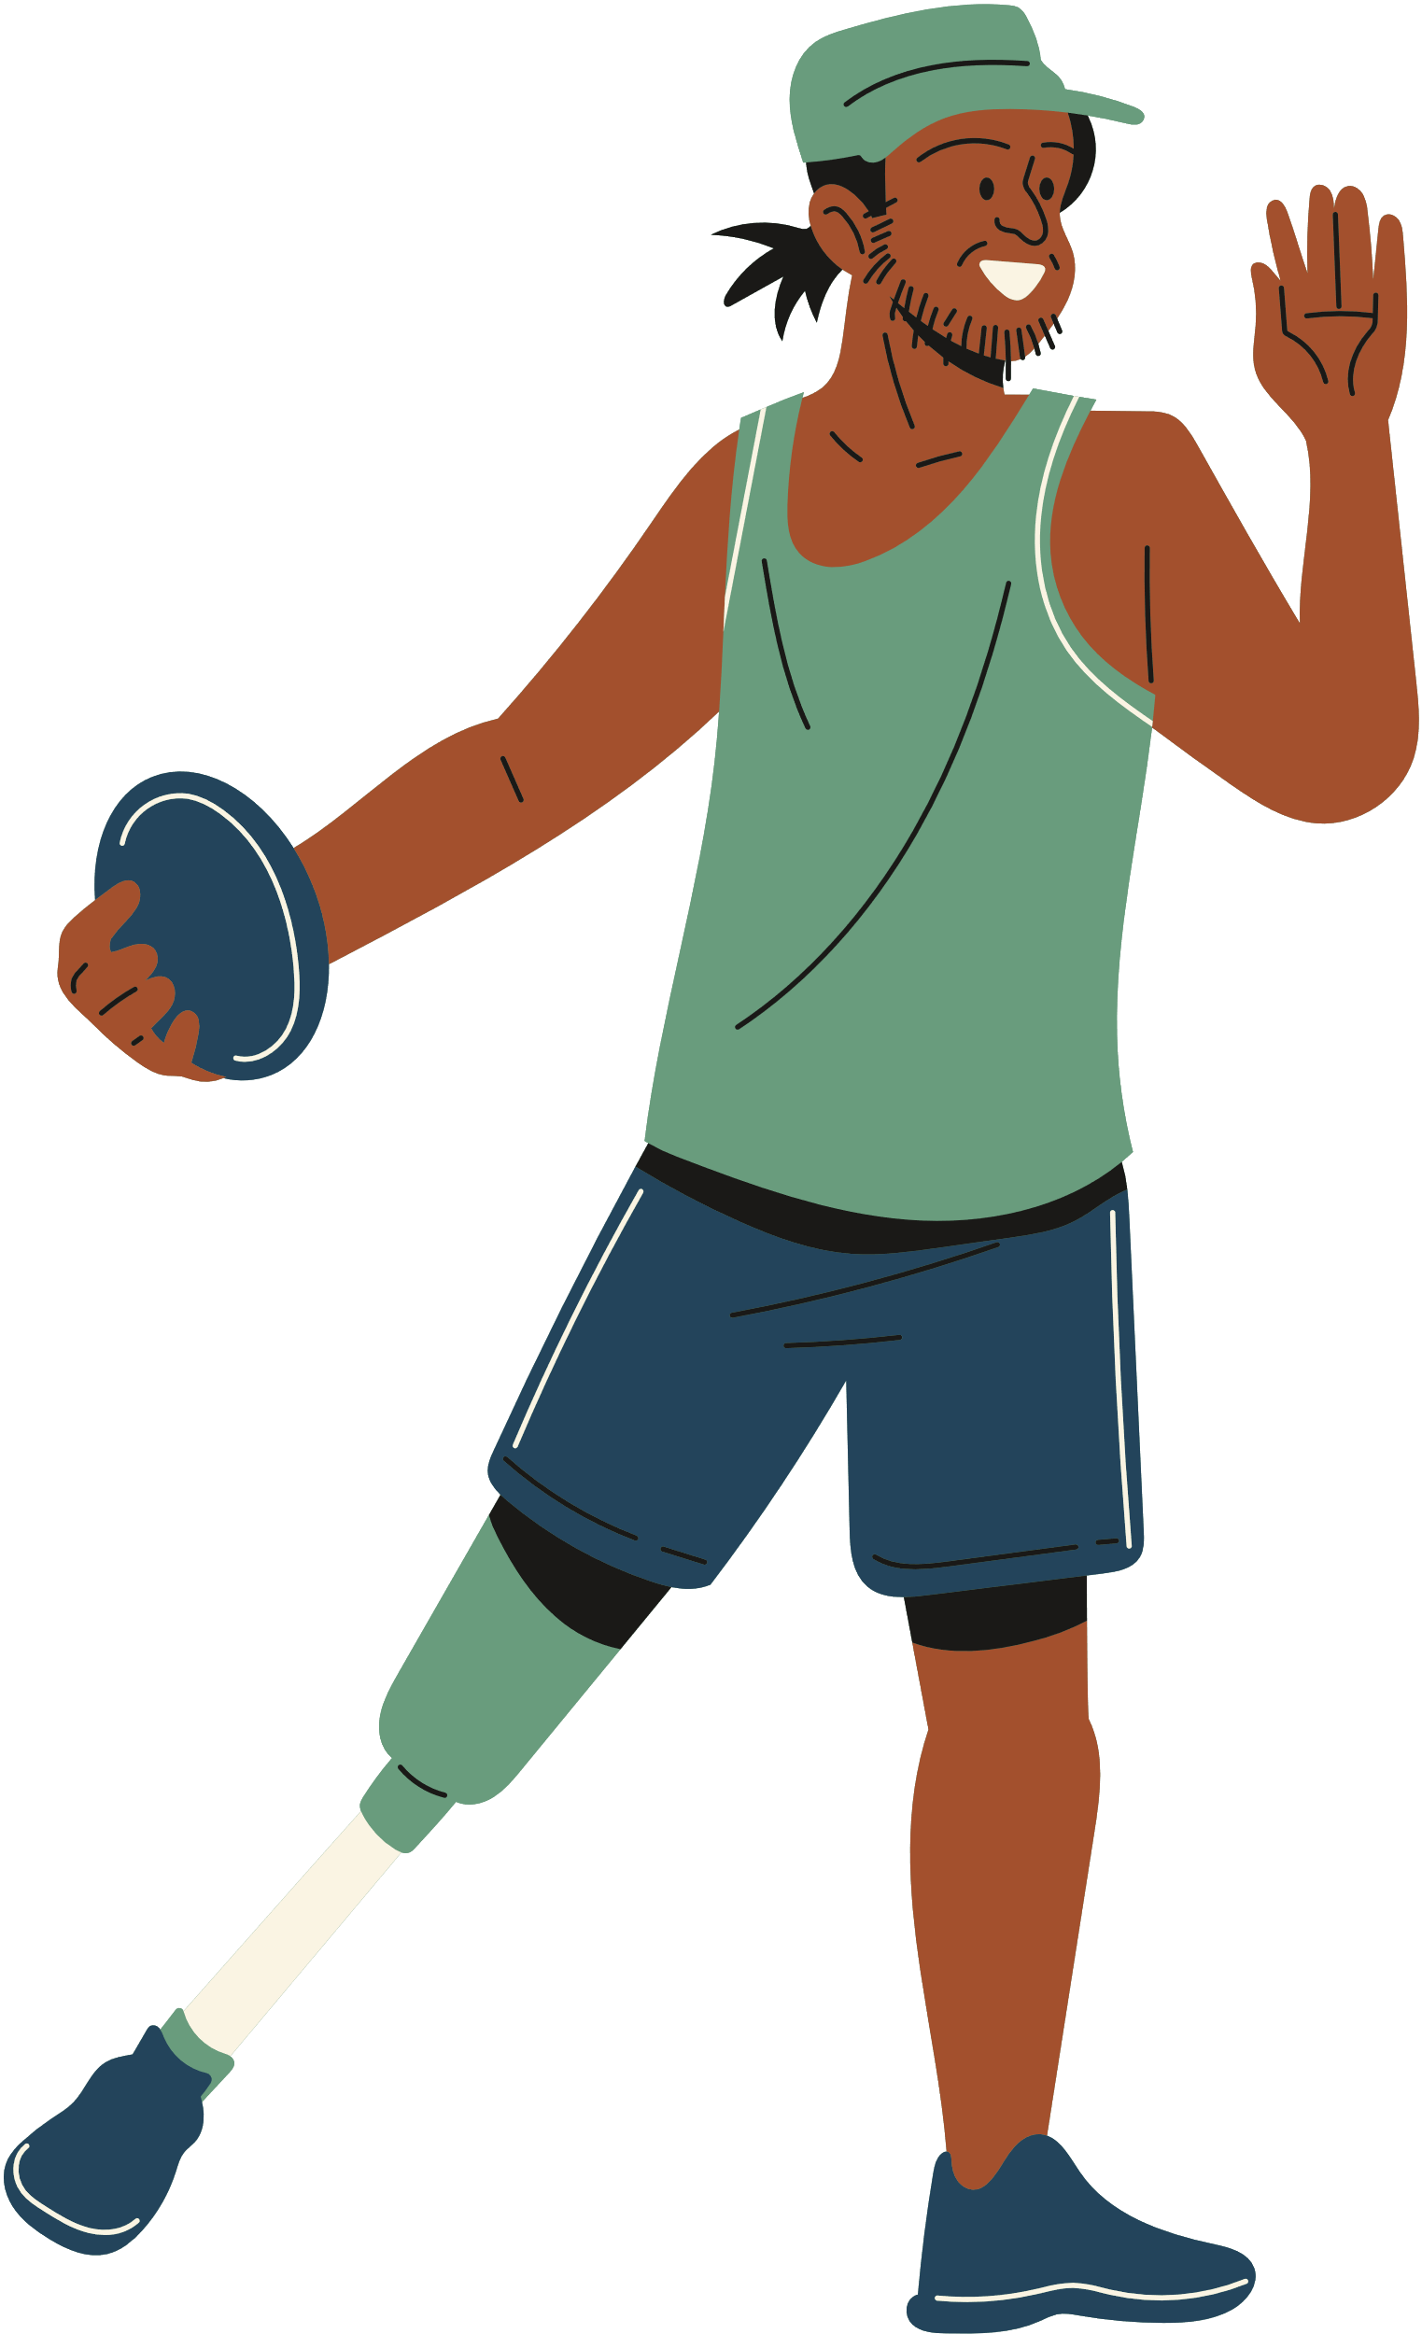
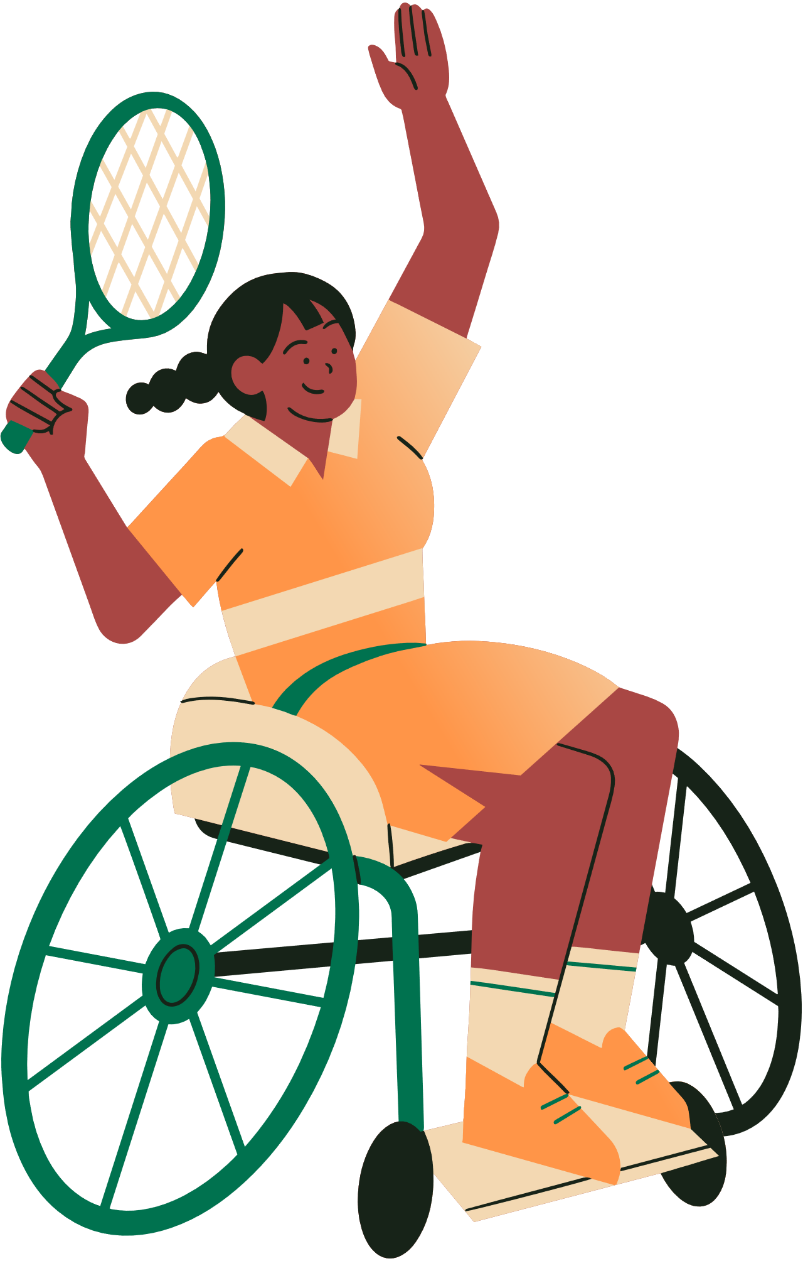
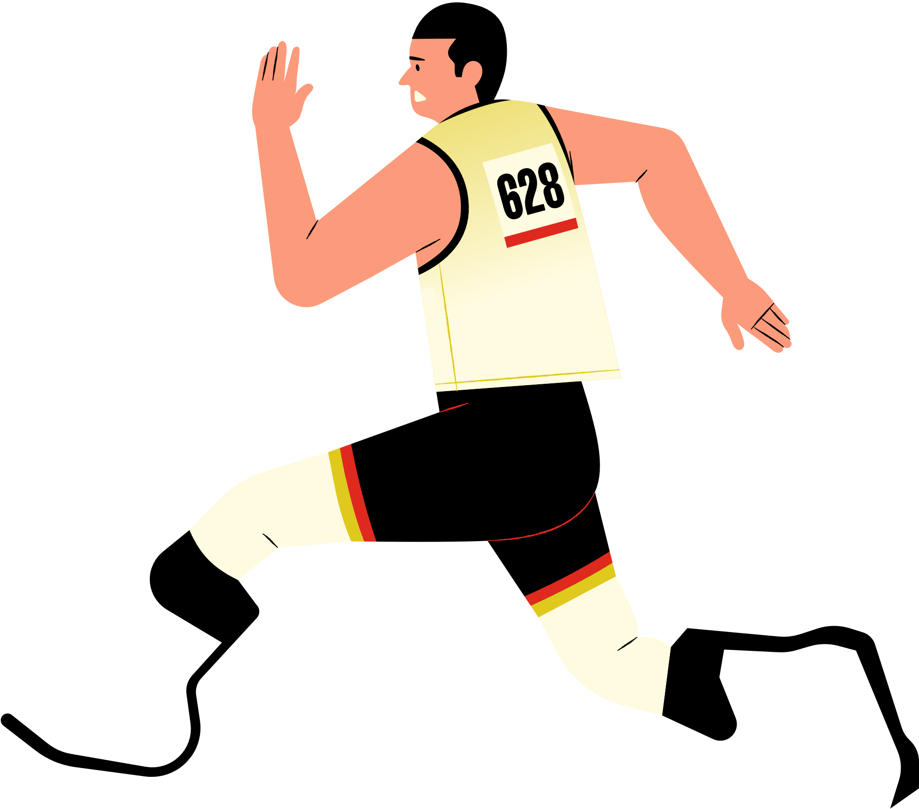
Conclusion
The pressure sensor patch provides a practical solution to prevent pressure sores, a serious risk for individuals with limited mobility. By offering real-time alerts and data insights, it enables users to take on new challenges without the constant fear of developing pressure sores.
This technology empowers patients, caregivers, and healthcare providers to focus on recovery and quality of life with confidence.

